Slide 1

Attrition data
Unified Mentor Data Science Internship Project
S Venkata Sai Hemanth Kumar Reddy

Slide 2
Overview
Attrition data provides a comprehensive view of employee turnover within an organization, encompassing essential details such as employee identifiers, reasons for departure, departure dates, tenure, job levels or departments affected, and insights from exit interviews. This data is instrumental in identifying patterns and trends in employee turnover over time, enabling organizations to pinpoint areas of concern and implement targeted retention strategies. By analyzing attrition data, companies can assess the effectiveness of current HR practices, understand the drivers behind employee departures, and mitigate potential talent loss by improving workplace conditions, career development opportunities, and overall employee satisfaction. Moreover, the data facilitates benchmarking against industry norms to gauge competitive positioning and strategic HR planning.

Slide 3



Tools and Technologies
Language: Python
Libraries : Pandas, NumPy, Matplotlib, Seaborn
Environment: Jupyter Notebook

Slide 4
Deliverables:
Jupyter Notebook with code and explanations.
Visualizations showcasing segmentation and insights.
Concise report summarizing analysis and recommendations.

Slide 5
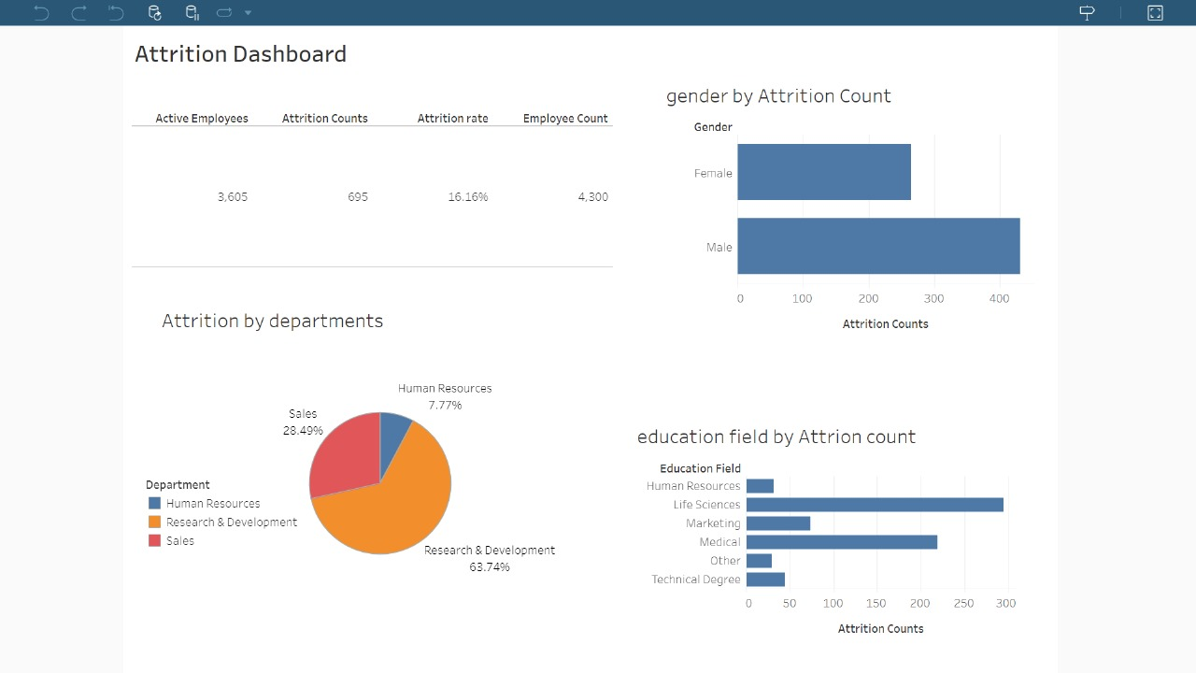
My Dashboards Using Tableau

Slide 6
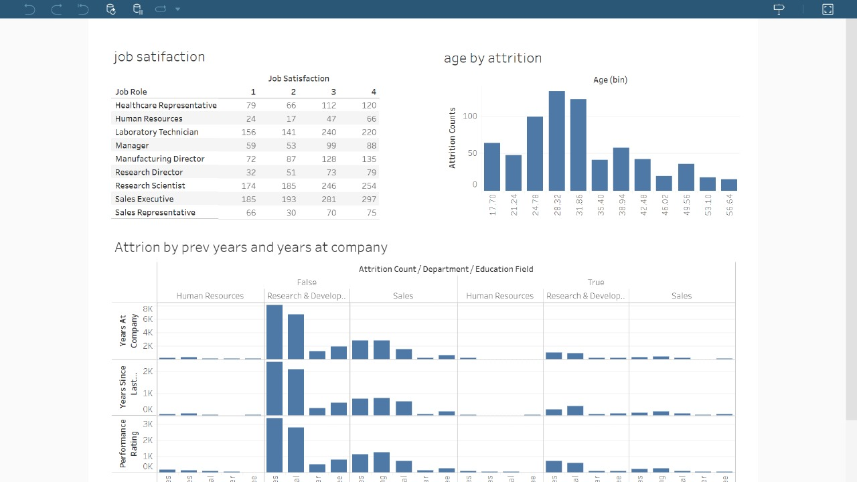

Slide 7
Thank you

